Slide 2

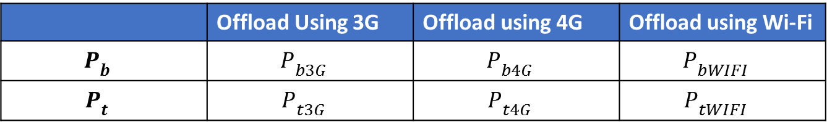
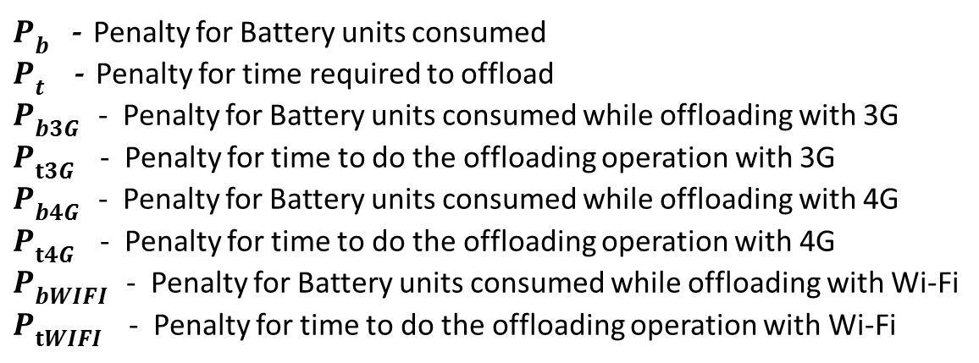
 | Offload Using 3G | Offload using 4G | Offload using Wi-Fi
$$P_{b^{}}$$ | $$P_{{b3G}^{}}$$ | $$P_{{b4G}^{}}$$ | $$P_{{bWIFI}^{}}$$
$$P_{t^{}}$$ | $$P_{{t3G}^{}}$$ | $$P_{{t4G}^{}}$$ | $$P_{{tWIFI}^{}}$$
$p=P_{{b3G}^{}}∗x+P_{{t3G}^{}}∗$ y
$P_{b^{}}$- Penalty for Battery units consumed
$P_{t^{}}$ - Penalty for time required to offload
$P_{{b3G}^{}}$- Penalty for Battery units consumed while offloading with 3G
$P_{{t3G}^{}}$- Penalty for time to do the offloading operation with 3G
$P_{{b4G}^{}}$- Penalty for Battery units consumed while offloading with 4G
$P_{{t4G}^{}}$ - Penalty for time to do the offloading operation with 4G
$P_{{bWIFI}^{}}$- Penalty for Battery units consumed while offloading with Wi-Fi
$P_{{tWIFI}^{}}$ - Penalty for time to do the offloading operation with Wi-Fi

